Slide 1
SURVIVE and THRIVE
Transforming care for every
small and sick newborn

Slide 2
WHY THIS REPORT?
Urgency: a decade to meet SDG targets, and those for every newborn to survive, and thrive are off track, maybe more so after COVID-19 pandemic. Some countries may not meet SDG3.2 target until a century too late
UHC: Small & sick newborns are our most vulnerable citizens and their care is a key part of UHC. Every country can do more
Opportunity: 94 authors from every continent (except Antarctica!) have been involved, showing wide commitment to this issue.
Chapter 1: Now is the time to transform care for newborns
Chapter 2: What the numbers say
Chapter 3: Deliver the care they are entitled to
Chapter 4: Ensure they thrive
Chapter 5: Use data for action
Chapter 6: Immediate action is needed
NOW!
Access report at bit.ly/care4everynewborn
Notes:
Overall slide: why, who, what

Slide 3

Notes:
Collaborators.

Slide 4

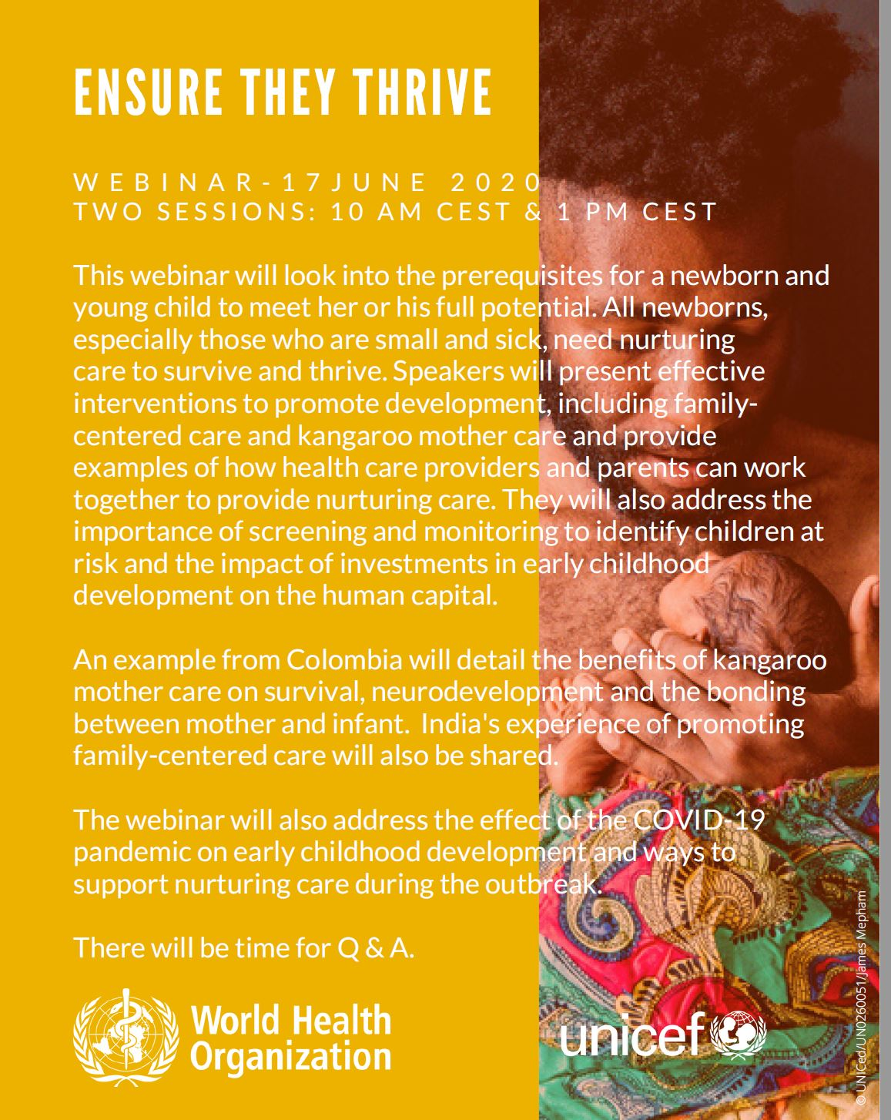


AGENDA – Session 2
Facilitator: Dr. Tedbabe Degefie Hailegebriel
Senior Adviser, Maternal and Newborn Health, UNICEF
• Introduction to the webinar series and the speakers – Dr.
Tedbabe Degefie Hailegebriel, UNICEF
• Key findings of ‘Ensure they thrive’, Chapter 4 of the Survive and Thrive report – Dr. Susan Niermeyer, Professor of Pediatrics, University of Colorado School of Medicine
Dr. Tedbabe Degefie Hailegebriel
Type headline
The impact of kangaroo mother care on survival, neurodevelopment and the bonding between mother and infant: an example from Colombia – Dr. Nathalie Charpak, associate researcher at the Pontifical Javeriana University, Bogota.
• COVID-19 impact on early childhood development and ways to support nurturing care during the outbreak– Dr. Tedbabe Degefie Hailegebriel, UNICEF
• Questions and answers
• Closing and next webinar
Dr. Susan Niermeyer Palamountain
Dr. Nathalie Charpak
Notes:
SESSION 2 – 11 am GMT
1. Dr. Niermeyer is a Senior Medical Advisor for Newborn Health at USAID in Washington, DC, USA and Professor of Pediatrics, University of Colorado School of Medicine, Aurora, CO, USA.
Dr. Nathalie Charpak isDirector of the Kangaroo Foundation, and an associate researcher at the Pontifical Javeriana University, Bogota, Colombia.
Dr. Dr. Tedbabe Degefie Hailegebriel is a Senior Adviser on Maternal and Newborn Health at UNICEF.

Slide 5
CHAPTER 4
Ensure they thrive

Slide 6
KEY MESSAGES
Every newborn and young child’s ability to thrive is the direct result
of nurturing care and positive interaction with their environment.
All newborns, especially those who have had major complications
at birth and during the neonatal period, require regular follow-up
and nurturing care to optimize development.
Investments in early childhood development benefit individuals, communities and countries.

Slide 7

KEY MESSAGES
1. THRIVE:
Newborns require
nurturing care
and positive interaction
with their environment.

Slide 8

What does it mean to thrive?
An individual who thrives is able to develop his or her
full potential, from conception through early childhood
Developmental potential is holistic and includes cognition,
social and emotional interactions, linguistic and motor skills.
The first 1000 days (from conception to 24 months) is critical in the context of preterm birth & neonatal illness.
Thriving is the process of maturing through interactions between the child and the environment.
Notes:
An important part of a child’s developmental potential involves having an environment marked by nurturing care.
WHO, UNICEF, World Bank nurturing care framework

Slide 9
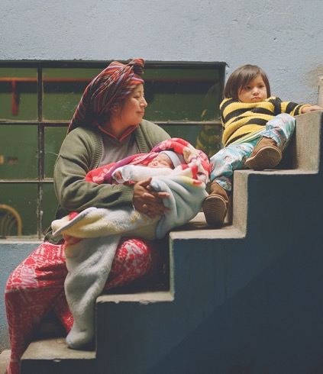
Why is early childhood so significant?
Once-in-a-lifetime opportunity to develop the brain, a period that is foundational to later health, functioning
and well-being
The infant’s brain depends on nurturing care for healthy development
Lack of nurturing care may lead to lowered cognitive, language, executive functioning, psychosocial outcomes
Protective factors (e.g. early stimulation and responsive care, good nutrition and protection) can offset some risk factors
Investments in care not only benefit individuals,
but also communities and countries
Notes:
Concept of critical period or window of opportunity
greater social cohesion and stability, higher productivity and earnings

Slide 10
Importance of integrating developmentally supportive care for small and sick newborns
Programmes are needed to deliver packages of interventions that provide nurturing care to promote developmental potential of the infant and young child
in the first 1000 days
Newborns at greatest risk of suffering from developmental delays, physical disabilities, & poor neurodevelopmental functioning:
  Small for gestational age
  Premature or low birthweight
  Afflicted with neonatal infections, intrapartum-related complications, neonatal jaundice
Notes:
While many low- and middle-income countries (LMIC) settings offer oxygen to preterm newborns, not able to provide blended oxygen (i.e. <100%)
Potent risk factor for increased visual impairment
LBW newborns @ Greater risk for academic difficulties and behaviour problems vs. newborns of normal birthweight

Slide 11
KEY MESSAGES
2. OPTIMIZE DEVELOPMENT:
All newborns, especially those
who are small and sick, need
regular follow-up & nurturing
care to survive and thrive.

Slide 12
Effective interventions to promote development
Adapted from: Altimier L, Phillips R. Newborn & Infant NsgRev 2016; 16:230.
Notes:
In HICs, early interventions have been shown to improve cognitive and social-development outcomes with effects lasting into childhood and adulthood
Health-care providers and parents and families need to have special understanding and skills to optimize nurturing care for small and sick newborns.
Family-Centred Care
Unit of care = infant, parents/primary caregivers, health care providers
fundamental principles: dignity and respect, information sharing, participation, collaboration
Healing Sensory Environment:
Healthcare providers
Recognize and be responsive to behavioural cues of nonverbal infants, help parents develop same comprehension

Slide 13
How health care professionals can support development
Providers should:
  Recognize and be responsive to behavioural cues of nonverbal infants
  Structure environment and incorporate individualized care provided by parents
  Educate and empower parents to be effectively engaged in care-giving in hospital and at home
Recommended caregiving behavior:
Notes:
Health care providers should:
Recognize and be responsive to behavioural cues of nonverbal infants
Act on newborn’s behalf to structure environment, incorporate individualized care provided by parents
Educate and empower parents to be effectively engaged in care-giving in the hospital and at home
Caregivers can change their behavior to support development in the facility with regards to positioning, touch, breastfeeding during painful procedure, and swaddled bathing
Image sources f rom Left to right, top to bottom:
http://ijn.mums.ac.ir/article_8515_6769fc9e01236912fdfba47ec6fcbbc6.pdf
https://newbornsbaby.blogspot.com/2019/08/premature-baby-posture.html
https://newbornsbaby.blogspot.com/2019/12/premature-baby-massage.html
https://researchfeatures.com/2016/11/22/pain-relief-infants/
http://www.dandlelion-webinars.com/wp-content/uploads/2013/02/Tender-Loving-Baths-in-the-NICI.pdf
https://marshall-denton.squarespace.com/s/TurtleTubCustomerPresentationrevC.pdf

Slide 14
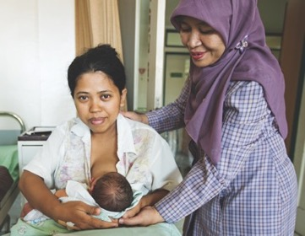
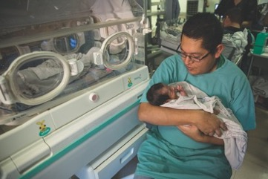
Effective interventions to promote development
Parent & Family Engagement
Contributes to newborn care during hospitalization
  Feed with mother’s own or donated breastmilk
  Practice good hygiene for self & baby
  Recognize & respond to baby’s cues
  about hunger & discomfort
  Ensure baby is fed, warm, clean, sleeping well, comforted
  Provide appropriate sensory stimulation,
  especially touch and vocalization
Fosters greater emotional connection with newborn and improve parenting abilities
Notes:
Parent/family engagement: Contribute to newborn care during hospitalization with basic care-giving

Slide 15

Kangaroo mother care: 20 years on
Setting: Colombia
Study 1 (1993-1996)
Randomized controlled trials
of newborns weighing <1000 g at birth
Documented Kangaroo Mother Care (KMC)
benefits on survival, neurodevelopment,
breastfeeding, quality of mother–infant bonding
Follow-up Study (2012-2014), n=264
KMC had significant, long-lasting social & behavioural protective effects,
magnified by longer duration of skin-to-skin contact and participation of fathers
Source: Charpak N et al. Pediatrics 2017; 139(1):pii:e20162063.
Notes:
Box 4.1
KMC programs with support to families at time of discharge and through follow-up services until 2 years of age, like the one in Bogota, Colombia, show encouraging long term benefits
Study 2 results:
Parents: more protective and nurturing, higher hourly wages
Children: larger cerebral volumes; reduced school absenteeism, hyperactivity, aggressiveness, externalization & socio-deviant conduct
Reference: Charpak N, Tessier R, Ruiz JG, Hernandez JT, Uriza F, Villegas J, et al. Twenty-year follow-up of kangaroo mother care versus traditional care. Pediatrics. 2017;139(1): pii: e20162063.

Slide 16
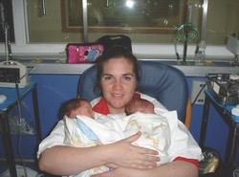
A Parent’s Story
A Mexican mother fights for her twins and goes on to support other parents internationally
“It was 36 hours after birth until I could see my children again. I told the staff
to please take a picture for me.
That is how I met my twins…
There was a lack of follow-up care…
a lack of emotional support
when my kids were young.”
– Ilein Bolaños Gonzalez,
founder of Con Amor Vencerás
Pictured: Ilein with son Alonso and daughter Camila
Notes:
Ilein Bolaños Gonzalez’s fraternal twin pregnancy, C-section at 32 weeks’ gestation, Her son Alonso was 1.5 kg, and her daughter Camila was 1.6 kg.
Ilein only saw her babies for a few seconds before the doctors whisked them away to the neonatal care unit.
“It was very strange,” she remembered. “It was 36 hours until I could see them again. I told the staff to please take a picture for me. That is how I met my twins.”
IIein struggled with the unnatural separation. “The visiting hours for the neonatal care unit were from 10:00 in the morning until noon and then from 5:00 to 8:00 in the evening,” she recalled. “It was terrible to be away from them.”
Relatively brief hospitalization of 24 days, but more challenges after discharge:
At the age of 2, Camila was diagnosed with nephrotic syndrome, since resolved
Alonso has faced some issues common in children born preterm, including kidney problems as well as difficulties eating, sleeping, and focusing
Both twins struggled with sensory processing.
So Ilein started a parent support group at her twins’ hospital. Later, she joined forces with another affected mother to build NGO, Con Amor Vencerás (“With Love, You Will Win”) = focuses on improving policies and increasing emotional support for families of small and sick newborns.
-representatives in 22 cities in Mexico and 5 countries in Latin America
created a manual for parents to develop their own local support groups-
Currently hosts 1 of 1st and largest prematurity-focused online support groups in Latin America

Slide 17
KEY MESSAGES
3. INVEST:
Investments in
early childhood development
benefit individuals,
communities and countries.

Slide 18
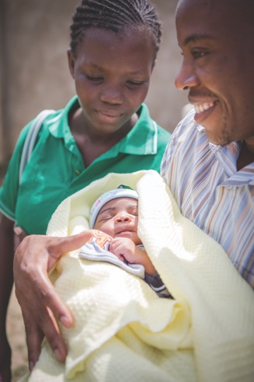
Discharge and beyond: empowering parents and caregivers
Parents and caregivers frequently report feeling
less than fully confident about caring for newborns
after discharge
Support caregiving at home and improve home environment, parental mental health & confidence with:
  Robust discharge plan sensitive to parents’ needs
  Discharge education accommodating parental schedules
  & preferred learning styles
  Individualized education programmes
  Parent support forums
Notes:
Individualized education programmes that discuss problem-solving, behavioural cues and appropriate interaction

Slide 19
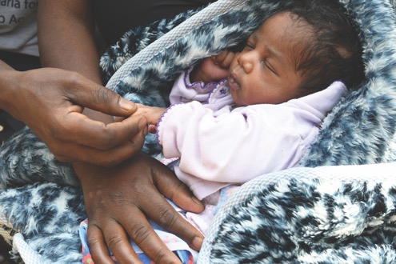
At-home interventions
Ensure baby is fed, warm, clean,
sleeping well, and comforted
Provide early stimulation,
shown to have short-term benefits
to cognitive, motor, social-emotional
development for LBW infants in LMICs
Encourage infant and young child to:
  Explore the environment using sight, touch, sound and smell
  Manipulate objects
  Interact socially with caregivers
Sources: Engle PL et al. Lancet. 2011;378(9799):1339–53.
Aboud FE, Yousafzai AK. Reproductive, Maternal, Newborn, and Child Health. 2016:241.
Notes:
Early interventions have also been effective in rural disadvantaged settings.
References:
Engle PL, Fernald LCH, Alderman H, Behrman J, O’Gara C, Yousafzai A, et al. Strategies for reducing inequalities and improving developmental outcomes for young children in low-income and middle-income countries. Lancet. 2011;378(9799):1339–53.
Aboud FE, Yousafzai AK. Very early childhood development. Reproductive, Maternal, Newborn, and Child Health. 2016:241.

Slide 20

At-home interventions
Deliver sensitive and responsive caregiving/feeding
  Benefits child development and academic outcomes, decreases hospitalizations
Demonstrated results
  Reduces parental stress levels,
  supports more positive maternal behaviour,
  improves maternal–infant interactions
  LMICs: consistent benefits for disadvantaged children, particularly those at risk of malnutrition
Sources: Eshel N et al. Bull World Health Organ. 2006;84(12):991–8.
Brett Jet al. BMJ Open. 2011;1(1):e000023.
Charpak N et al. Pediatrics. 2017;139(1): pii: e20162063.
Aboud FE, Yousafzai AK. Annu Rev Psychol. 2015;66(1):433–57.
Britto PR et al. Lancet. 2017;389(10064):91–102.
Notes:
References:
Eshel N, Daelmans B, Mello MCd, Martines J. Responsive parenting: interventions and outcomes. Bull World Health Organ. 2006;84(12):991–8.
Brett J, Staniszewska S, Newburn M, Jones N, Taylor L. A systematic mapping review of effective interventions for communicating with, supporting and providing information to parents of preterm infants. BMJ Open. 2011;1(1):e000023.
Charpak N, Tessier R, Ruiz JG, Hernandez JT, Uriza F, Villegas J, et al. Twenty-year follow-up of kangaroo mother care versus traditional care. Pediatrics. 2017;139(1): pii: e20162063.
Aboud FE, Yousafzai AK. Global health and development in early childhood. Annu Rev Psychol. 2015;66(1):433–57.
Britto PR, Lye SJ, Proulx K, Yousafzai AK, Matthews SG, Vaivada T, et al. Nurturing care: promoting early childhood development. Lancet. 2017;389(10064):91–102.
Additional references:
WHO. Caring for the newborn at home. Geneva: World Health Organization; 2015 (http://www.who.int/ maternal_child_adolescent/documents/caring-for-thenewborn-
at-home/en/, accessed 28 February 2019).
Walker SP, Chang SM, Powell CA, Grantham-McGregor SM. Psychosocial intervention improves the development of term low-birth-weight infants. J Nutr. 2004;134(6):1417.
Walker SP, Chang SM, Younger N, Grantham-McGregor SM. The effect of psychosocial stimulation on cognition and behaviour at 6 years in a cohort of term, low-birthweight Jamaican children. Dev Med Child Neurol. 2010;52(7):e154.

Slide 21
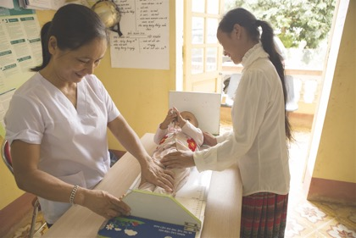
Screening and Monitoring
Newborn screening programmes hold promise for
prevention and access to needed early interventions
Screening and monitoring for early childhood
development is important across developmental
stages, even into school age in some cases
Assessment approaches are increasingly available for individual children, to evaluate programs and to monitor populations
Connecting early identification of delays or disability to quality early intervention programmes will be important to assure the healthiest possible child and family outcomes

Slide 22
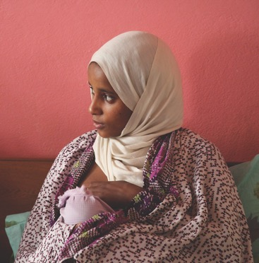
Screening for Parental Distress
Screening is important to identify parents at risk and
emotional distress experiences in NICU
Stress and distress are amplified in humanitarian crises
Staff should be trained to screen for parental distress
Families should be linked to resources for appropriate care and support
Notes:
Important to screen for parental distress:
Emotional distress experienced at NICU can disrupt infant-parent bonding,
reduce a parent’s self-confidence as a caregiver
Mothers are more at risk for anxiety and depression, which can lead to long-term negative consequences on child’s behavioural and cognitive development

Slide 23
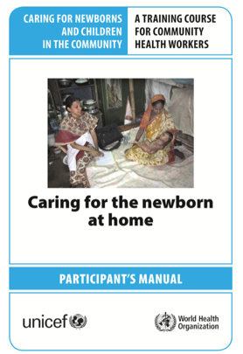
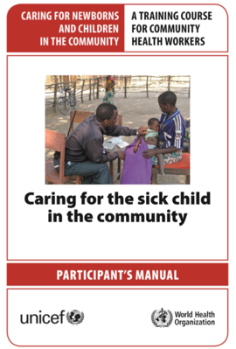
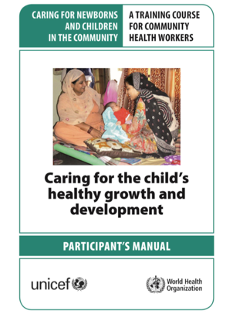
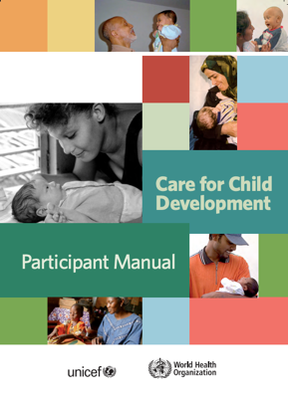
Global guidelines for community practitioners
WHO and UNICEF global care guidelines
Other guidelines on nurturing care for small & sick newborns: forthcoming
Notes:
Box 4.2
Setting: limited access to quality health services, conditions of poverty, disadvantage and fragility
Caring for the Newborn at Home
For at-risk newborn, addresses special care considerations for LBW newborns
Antenatal and newborn care delivered during pregnancy + for 1 week after birth
5 home visits
Additional packages (focus on the development of all children, or sick children who are not necessarily small or preterm. These detail the health and nutritional needs of young children, along with early stimulation and responsive caregiving practices)
Caring for a Child’s Healthy Growth and Development
Caring for the Sick Child in the Community
Care for Child Development

Slide 24
Conclusion
Programmes are needed to integrate early childhood development
with interventions in the first 1000 days
Support the newborn and family through early detection of disability
or developmental delay and routine follow-up
Prioritize developmentally supportive care to improve outcomes for newborns: foster a family-centred, nurturing, supportive sensory environment
With the right care, small and sick newborns can survive and thrive.
Notes:
Call to action.
Small and sick newborns are at greatest risk of suffering from developmental delays, physical disabilities and poor neurodevelopmental functioning
Emerging evidence that disabilities may be prevented/mitigated with good-quality, developmentally supportive care for small and sick newborns
Parents and family members can serve as important partners in delivering well-timed, consistent and appropriate care with vigilant follow-up of at-risk newborns

Slide 25
Join the Small and Sick Newborn Care Community of Practice
You can register at https://ibpnetwork.org/topics/14356
and click on “request invitation"
SSNC CoP is hosted by WHO ibp network
Access report at: bit.ly/care4everynewborn

Slide 26
COVID-19 pandemic Effect on Early Childhood Development
Economic and structural impacts:
  Rises in poverty and food insecurity, loss of caregivers, and reduced access and use of health care
Social and psychological impacts:
  Stress and depression experienced by caregivers, undermining their ability to provide consistent nurturing care
Impact is on entire life course of the child, but also future generations
Stenz, L., Schechter, D.S., Serpa, S.R., and Paoloni-Giacobino, A. Intergenerational transmission of DNA methylation signatures associated with early life stress. Current genomics. 2018; 19: 665–675
Effects of the Global COVID-19 Pandemic on Early Childhood Development: Short- and Long-Term Risks and Mitigating Program and Policy Actions.https://www.jpeds.com/article/S0022-3476(20)30606-5/fulltext
Notes:
Health system challenges in MNH:
- Maintain essential maternal and neonatal care services
- Prevent decrease in utilization on MNH services
- Respond to the needs of women and newborns with COVID-19

Slide 27
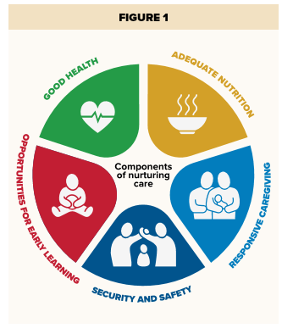
Ways to Support Nurturing Care during COVID-19:Responsive Care Giving, Health and Nutrition
Promote family-centered care during delivery, hospitalization and after-home care.
Provide pregnant women/new mothers counselling on health/breastfeeding/care during COVID-19
Use health and nutrition platforms to deliver messages on coping, parenting and early stimulation
Promote family handwashing and hygiene
Emergency food delivery, including micronutrient and ready-to-use therapeutic food supplements for pregnant women and young children
Notes:
The early years are a critical period to build human capital
Support parents to take care of their own physical and mental well-being so they can better provide nurturing care for their children

Slide 28
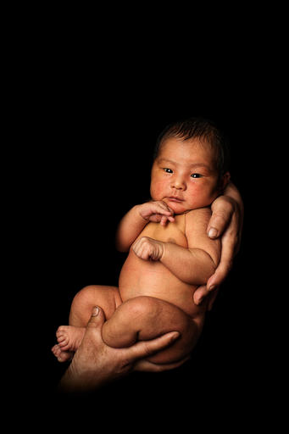
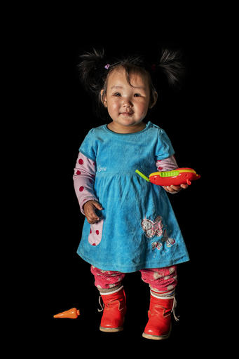
Ways to Support Nurturing Care, Security and Safety during COVID-19 pandemic
Ensure ECD is prioritized within the COVID-19 response to protect this generation of young children
Reach parents with income and mental health support, encouragement and practical ideas
Targeted childcare and psychosocial support for essential workers on the frontline of the crisis
Support parents to take care of their own physical and mental well-being so they can better provide nurturing care for their children
Set up support services for women and children experiencing domestic violence and abuse
Notes:
The early years are a critical period to build human capital. Strategic investments in ECD need to be prioritized within the COVID-19 response to protect this generation of young children
Ensure information campaigns integrate key messages to promote ECD and nurturing care, related to nutrition, health, stimulation and learning, violence prevention and psychosocial support
Respect for the role of family members as care partners and maintain family integrity.
Ensure the collaboration between family members and the healthcare team

Slide 29

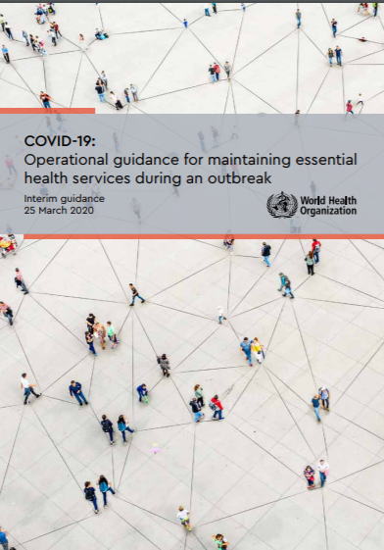
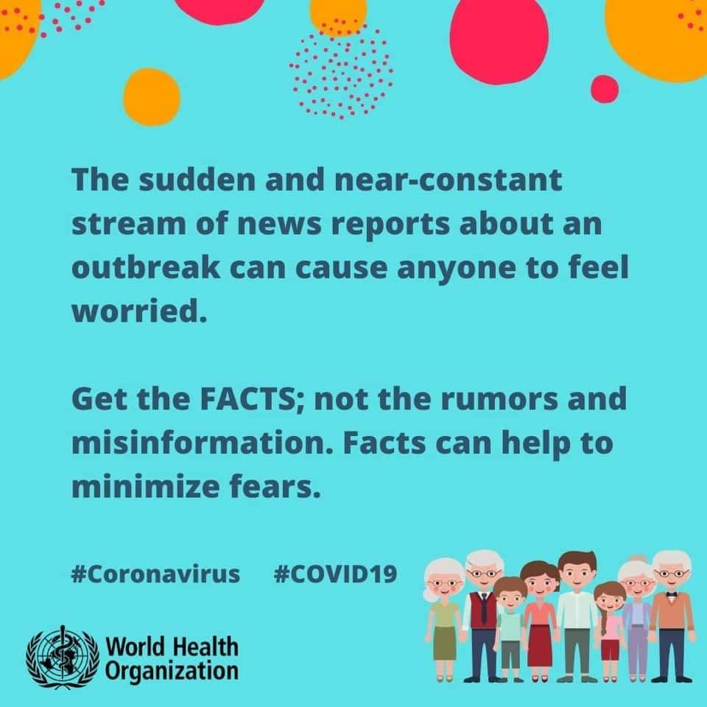
Resources on healthy parenting and mental health in the COVID-19 context
https://www.who.int/news-room/campaigns/connecting-the-world-to-combat-coronavirus/healthyathome/healthyathome---healthy-parenting
https://www.who.int/news-room/campaigns/connecting-the-world-to-combat-coronavirus/healthyathome/healthyathome---mental-health
EHS guidance: https://www.who.int/publications-detail/10665-332240
https://www.unicef.org/parenting/coronavirus-covid-19-guide-parents

Slide 30
Notes:
Closing slide.

Slide 31
Acknowledgments
Authors for Chapter 4
Pia Britto, Nathalie Charpack, Bernadette Daelmans, Arti Maria, Janna Patterson, Susan Niermeyer
Managing Editors for the Report
Lily Kak, Joy Lawn, Ornella Lincetto, Gina Murphy, Judith Robb-McCord,
Nabila Zaka
PowerPoint slides and graphics
Stefanie Kong, Kayley LeFaiver
Overall >94 authors and experts from all over the world have input and all are appreciated!

Slide 32
Check out the webinar series: bit.ly/NewbornSeries
Register for the next webinar on 1st July: ‘Use data for action’:
8 am GMT session: bit.ly/01JulyS1
11 am GMT session: bit.ly/01JulyS2
Join the conversation: #EveryNewborn, #EveryChildAlive
  Join the Community of Practice for the care of the small and sick newborn:
  Register at https://ibpnetwork.org/topics/14356
  Online kick-off event 24 June 2 pm GMT
Access report at: bit.ly/care4everynewborn
Notes:
Overall slide: why, who, what

