Slide 1
Developing, testing, and implementing changes
Esther Karamagi (MBChB, MSc)
Chief of Party, USAID ASSIST project, Uganda
Sr. Atim Mary
Anaka hospital, Northern Uganda
WHO QoC webinar
Notes:
to reduce mm by half in 5 years. we need to create teams at communities and facilities to continuously test and implement changes in the way they operate

Slide 2
Quality Improvement Steps
Step 1: Identifying a problem, forming a team and writing an aim statement
Step 2: Analyzing the problem and measuring quality of care
Step 3: Developing and testing changes
Step 4: Sustaining improvement
From
POCQI Coaching material (WHO 2017)

Slide 3
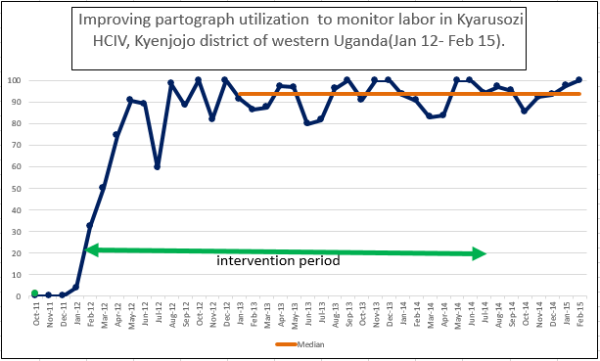

Slide 4
PDSA example: improve partogram use
Identified problem: partogram was used at 4% of deliveries in January 2012
Analysis: 5 possible causes
partogram not available when needed,
partogram incompletely/incorrectly filled,
partogram not completed for referred patients
partogram not completed for patients managed by 2 shifts,
deliveries at night not monitored with partogram.
Develop solutions/possible changes
Notes:
Describe process of coming up with changes: one root cause at a time, QI team may brainstorm, pick ideas from a change package, etc. They agree on one change which they think will work.

Slide 5
Inputs and processes
Root causes
In puts (Provide or Improvise)
Processes (Test changes)
Improve availability of partograms
Improve completeness and accuracy of partograps
Other processes
partogram,
Staff training,
others
PDSAs
Improved performance

Slide 6
Ensuring availability of partogram for every patient every time
Problems with ensuring availability
Sometimes there were no copies available in the facility
Even when there were copies available in the facility they were not always available at the time when they were needed
Periods of stock out whenever printed batch was used up
Changes
Move photocopier close by
Move partogram nearer
Assign someone to keep stock and print new partograms when stock is going down
Notes:
The team needed to figure out how to fix this problem
They had different ideas about who should make sure that the copies were close and attached to the sheet
They used PDSA cycles to learn which idea was most feasible and most effective

Slide 7
Partogram not at the patient side even when available in the facility

Slide 8
Partogram not at the patient side even when available in the facility
Partograph now attached to admission form

Slide 9
PDSA Cycle for process improvement
Do:
Test the solution;
Study:
Review performance. Look for evidence that the change worked
Act:
Discard solution, Modify solution, Develop new solution;
Implement successful solution
Plan:
Make a plan of action;
Communicate change

Slide 10
PDSA example
Do:
Test all of the next week day shift;
Study:
was the partogram available for all patients seen on the day shift?
Act:
Try stapling to be done by staff on duty
Plan:
in charge to do the stapling

Slide 11
Different sizes of PDSAs
Testing if an idea is feasible
Very small PDSA –
Who should staple the partogram to the admission form
? The in charge, ?The staff on duty, ? A specially assigned person
Testing if feasible ideas are effective
A bit larger test in a controlled setting
Once you have something that is feasible (they can move the forms and staple them to the admission forms) test if it can be consistently done for a short period, e.g. a whole week of day shifts
Testing if effective ideas are effective in a wide range of settings
Test in whole unit population
If it worked in day shift do it for evening and night shifts as well

Slide 12
Cycles on partogram availability for every patient every time
Change 2: move partograms to labor suite
PDSA 1: In charge stapling the partogram
PDSA 2: staff on duty stapling the partogram
PDSA 3: All stapling assigned to one staff
PDSA 4: Stapling done for day shift for a whole week
PDSA 5: Stapling done for all shifts
Cycles of iterative changes, resulting in improvement in partogram use
Week 1 week 5 week 10
Notes:
Testing one at a time helps know which change works

Slide 13
Several changes to address all causes of poor performance
1 move photocopier
2 move partogram stock
3 Assign stock management
4 separate files with incomplete partogram
5 immediate feedback on partogram
6 include in handover
7 include in referral documents
8 same number of staff in day and night
3
2
5
1
4
6
7
8
partogram available
Complete, correct use
Shift change
Referrals
night shift
Cycles of iterative changes, resulting in improvement in partogram use
4% 100%
Notes:
Several root causes addressed. Several cycles of testing. Each naturally leading to the next. this needs to become the way of doing work.support sites to form teams that constantly test changes.

Slide 14
Example: Anaka Hospital

Slide 15
Background
General district Hospital
Conducts 5 deliveries/day
Maternity unit has 7 Midwives
MNCH QI team consists of 10 members.

Slide 16
Anaka Hospital: Before SMGL
Before QI Support
QI Activities
No improvement team in Maternity
Mothers delivered rarely monitored on partograms
This led to 5-7 FSBs every quarter
partogram sheets were few.
Those available were locked up in the cupboard
There was inadequate knowledge and skills among midwives
Low attitude towards partogram use
Formed an MNCH improvement team
Assigned roles to each member
Used documentation journals to track performance
Team supported monthly by ASSIST coaches onsite
Team members participated in quarterly peer to peer learning meetings

Slide 17
Anaka Hospital: Changes tested
Printing/photocopying of partograms at the hospital and/or at district offices.
CME supplemented by one on one on job training
Attaching partograms to admission forms (stapled together).
Review of sampled partograms during QI team meetings for completeness and correct use

Slide 18
Anaka Hospital: Benefits of using partogram
FSBs have reduced to 1 every quarter
Partogram use has led to perceived increased attention to mothers during labor.
Client feedback is being obtained daily from mothers through the WHO quality of care work in the hospital.

Slide 20
What does it take?

Slide 21
Q&A

