Slide 1




Respectful Maternity Care For Healthcare Workers:
Tackling Disrespect & Abuse During Facility-Based Childbirth
Notes:
In every country and community around the world, pregnancy and childbirth are hugely important events in the lives of women and families. They are also a time of great vulnerability. The relationship with the maternity care system and with you as caregiver during this time is incredibly important.
In addition to bringing vital, possibly lifesaving health services, women's experiences with maternity caregivers have the power to give strength and comfort… or to cause lasting damage and emotional trauma. Either way, women's memories of their childbearing experiences stay with them for a lifetime.
Imagine the personal treatment you would expect from a maternity care provider entrusted to help you or a woman you love give birth. Naturally, we want good judgment and clinical competence, and we imagine a relationship that is characterized by caring, empathy, support, trust, confidence, empowerment, and gentle, respectful, effective communication.
Unfortunately, too many women experience care that does not match this image.
This presentation is about disrespect and abuse of women during maternity care, and what we can do to tackle this problem.

Slide 2
Disrespect & Abuse in
Childbirth: What We Know
A global problem
Occurs in low, medium, and high income countries
Many anecdotal reports, little formal research
No normative standard for respectful care
It is a violation of human rights
Notes:
Every day in countries all around the world….
Pregnant women seeking maternity care from the health systems in their countries instead receive ill treatment that ranges from relatively subtle disrespect of their autonomy and dignity to outright abuse: physical assault, verbal insults, discrimination, abandonment, or detention in facilities for failure to pay.
We might think that such traumatic experiences during maternity care occur in countries other than our own; however this is a global problem. Reports and studies of women’s experiences come from countries all around the world, including our own.
Some of us have known about this problem for a long time, and have witnessed or even experienced it ourselves, but we did not know who to tell or what to say. Perhaps in your facility, some of these behaviors are accepted as “normal” or harmless. In this way, a "veil of silence" has covered up the humiliation and abuse suffered by women seeking maternity care.
For example, there is little formal research on the prevalence and factors that contribute to this problem, and as a result we don’t know enough about effective interventions to eliminate disrespect and abuse. More research is still needed.
In addition, to date there is no agreement on what Respectful Maternity Care means. It is clear, however, when we look at international human rights standards, that disrespect and abuse is a violation of women’s basic human rights.

Slide 3
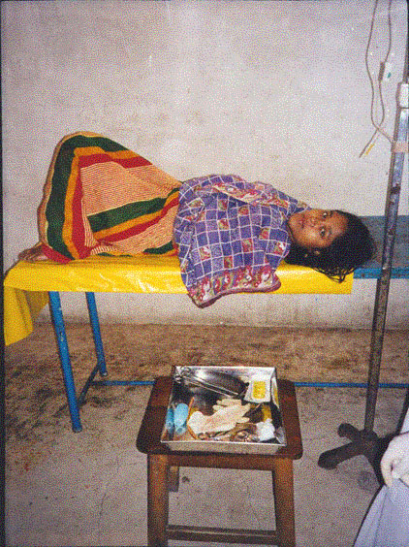
Categories of
Disrespect and Abuse
Physical Abuse
Non-Dignified Care
Non-Consented Care
Non-Confidential Care
Discrimination
Abandonment or Withholding of Care
Detention in Facilities
Bower and Hill (2010)
Source: USAID TrAction Project
Notes:
USAID recently commissioned a landscape review on the subject by Bowser and Hill (2010), "Exploring Evidence and Action for Respectful Care at Birth.“ This report attempted to capture what is currently known on the subject, through research studies, case reports, and interviews. The authors identified seven major categories of disrespect and abuse that occur during maternity care.
The following testimonials from women around the world are drawn from existing published reports—we are grateful to the researchers, advocates, and activists who have brought these women’s stories to light to help break the silence. We know there are many more stories from many more places that have still not been shared. Perhaps you have a story from your experience that should be shared.

Slide 4
1: Physical Abuse
"When a woman goes into the second stage of delivery, you don't want her to close her legs, so you're beating her."
— Kenya (Ogangah, Slattery, and Mehta Soon, 2007)
Notes:
Hitting, slapping, pushing or even roughly touching a woman is (removed the word “also”) the physical abuse. All physical contact with our patients should be as gentle, comforting, and reassuring as possible. Freedom from physical abuse is the right of each of our patients.

Slide 5
2: Non-consented Care
"Providing explanations to less educated women is a not a good use of time as 'they just can't understand'"
— South Africa (Fonn et al., 2001)
Notes:
Language use and level, educational attainment and cultural background may vary among our patients. All need careful explanation of proposed procedures in a language and at a level they can understand so that they can knowingly consent to or refuse a procedure. The freedom to consent to or refuse care is the right of each of our patients.

Slide 6
3: Non-confidential care
“…I was assisted by one of the patients who was waiting to give birth. The nurse later came and took the baby…then told me to get up and wipe the bed.”
-- Kenya (Ogangah, Slattery, and Mehta Soon, 2007)
Notes:
Patients have a right to privacy and confidentiality during the delivery of services. This includes privacy and confidentiality during counseling, physical examinations, and clinical procedures, as well as in the staff ’s handling of patients’ medical records and other personal information.
We must do whatever is possible to protect the privacy and confidentiality of our patients and to keep the mother and baby together at all times. Confidential care is a right of each of our patients.

Slide 7
4: Non-dignified Care
"One nurse told me: 'Lady, can't you see that you are in the way? Go over there, you aren't anything but an animal and talking to you is like talking to an animal."
-Dominican Republic (Miller et al., 2002)
Notes:
Every woman we care for is a person of value and is worthy of our respect. We must honor the dignity of each woman in our words, our actions, and all of our non-verbal communication. Dignified care is the right of each of our patients.
Dignity, comfort, and expression of opinion: All patients have the right to be treated
with respect and consideration. Service providers need to ensure that patients are as comfortable
as possible during procedures. Patients should be encouraged to express their
views freely, even when their views differ from those of service providers. Service providers also need to ask the patient for feedback.

Slide 8
5: Discrimination
"Everything that came out of her mouth was the color of my skin. She goes, 'You're the first dark person I've ever had.' I sat there and had to deal with that. After that, I left and never went back."
— USA (Amnesty International, 2010)
Notes:
All women are equally worthy of our respectful care regardless of ethnic background, culture, social standing, educational level or economic status. Discrimination is never okay. Non-discrimination is the right of each of our patients.

Slide 9
6: Abandonment of Care
"You just call until you get tired and then you finally deliver by yourself and die. I have even witnessed it myself."
- Kenya (Family Care International, The Skilled Care Initiative, 2005)
Notes:
A woman in labor or immediately after birth should never be left alone. If you must leave your patient, tell her when to expect your return and how to get help if needed. Attentive care is the right of each of our patients. Women should be able to have a companion of their choice, such as a family member or community doula, with them throughout labor and birth at the health facility to provide continuous support.

Slide 10
7: Detention in Facilities
"When I got the bill, the doctor said to me, 'Since you have not paid, we will keep you here.'"
— Burundi (Human Rights Watch, 2010)
Notes:
A woman or her baby should never be forcibly kept in a facility. Freedom from detention is the right of each of our patients.

Slide 11
  Impact on Safe Motherhood
Disrespect and abuse during facility-based childbirth have a negative impact on skilled birth care utilization
Reviewed studies suggest that fear of disrespect and abuse may sometimes be a more powerful deterrent to the use of skilled birth care than geographic and financial obstacles
Notes:
The concept of “safe motherhood” is usually restricted to physical safety, but safe motherhood is more than just the prevention of death and disability. It is respect for women’s basic human rights, including respect for women’s autonomy, dignity, feelings, choices, and preferences, including companionship during maternity care.
Recent studies illustrate this fact: a recent population-based study in Tanzania by Kruk and colleagues that examined women’s choices showed that “provider attitude” was the highest predictor, along with availability of commodities, of women’s choice to use facility-based childbirth services. It mattered to women more than cost, distance, and lack of availability of free transport (obstacles often cited in discussions about skilled care utilization).
This suggests that provider attitude is important in determining whether or not women deliver in facilities with skilled providers. Respectful care is a life-saving skill. Your treatment and care of each of your patients should result in their choice to return to your care whenever needed.
Population-based Study (Kruk et al, 2009, Tanzania)
Method: Population-Based Discrete Choice Experiment (N=1,203)
Result: Provider attitude & availability equipment/drugs most predictive of utilization facility childbirth services among 6 variables (higher than cost, distance, free transport)
Conclusion: Home deliveries would decrease by 17% if provider attitude improved

Slide 12
Discussion
Is this a problem that you have seen or heard about in maternity care facilities in your community or country?
Notes:
The White Ribbon Alliance for Safe Motherhood is bringing together concerned partners to develop collaborative strategies to address disrespect and abuse during maternity care. We are calling on people from across relevant sectors (research, clinical service delivery and education, human rights and civil society advocacy) and from countries around the world-- to eliminate disrespect and abuse in maternity care.
We believe that everyone has a part they can play to promote Respectful Maternity Care. Open discussion will allow us to develop a deeper understanding and to jointly strategize to bring effective programs, policies and advocacy to ensure that every woman's right to respectful care at birth is upheld.
Is this a problem that you have seen in your facility? Is there anybody working on this problem? What kinds of solutions are being tried and what is working? What would you suggest to prevent abuse and disrespect of women cared for in your facility?

Slide 13
Discussion
What does Respectful Maternity Care look like? What other factors impact Respectful Maternity Care?
Notes:
What do you think Respectful Maternity Care should look like? That may not be the care that is considered “normal” for your facility or culture. What other factors contribute to respectful care?
How can providers support respectful care of their patients AND respectful treatment of providers? What has been your experience in introducing this?

Slide 14
Discussion
What do healthcare workers need to provide Respectful Maternity Care?
Notes:
Health workers should expect respectful treatment:
Health care workers want to perform their duties well, but they must have administrative support and critical resources to be able to deliver the high-quality services to which patients are entitled. Lack of support, chronic staff shortages and lack of resources can lead to chronic frustration for providers and staff.
Acknowledging that patients have a right to expect certain things when they come for services is a powerful concept, and has implications for staff behavior and performance. Recognizing that service providers and other staff have needs that must be met if they are to provide quality services can be a motivating force among staff and supervisors.
The Needs of Health Care Workers
Facilitative supervision and management: Health care staff function best in a supportive work environment in which supervisors and managers encourage quality improvement and value staff. Such supervision enables staff to perform their tasks well and thus better meet the needs of their patients.
Information, training, and development: Health care staff need knowledge, skills, and ongoing training and professional development opportunities to remain up-to-date in their field and to continuously improve the quality of services they deliver.
Supplies, equipment, and infrastructure: Health care staff need reliable, sufficient inventories of supplies, instruments, and working equipment, as well as the infrastructure necessary to ensure the uninterrupted delivery of high-quality services.

Slide 15
The Charter
RESPECTFUL MATERNITY CARE:
THE UNIVERSAL RIGHTS
OF CHILDBEARING WOMEN
Category of Disrespect and Abuse ^{i} |  | Corresponding Right
1. | Physical abuse | Freedom from harm and ill treatment
2. | Non-consented care | Right to information, informed consent and refusal, and respect for choices and preferences, including companionship during maternity care
3. | Non-confidential care | Confidentiality, privacy
4. | Non-dignified care (including verbal abuse) | Dignity, respect
5. | Discrimination based on specific attributes | Equality, freedom from discrimination, equitable care
6. | Abandonment or denial of care | Right to timely healthcare and to the highest attainable level of health
7. | Detention in facilities | Liberty, autonomy, self-determination, and freedom from coercion
Notes:
Human rights are due to all people, have been recognized by societies and governments and held up in international declarations and conventions. To date, no universal charter or instrument shows how human rights apply to the childbearing process.
To promote Respectful Maternity Care, WRA facilitated the development of a rights charter, with broad input from its project partners and representatives from the network of WRA National Alliances and international NGOs around the globe who contributed to this consensus document.
Seven rights are included, drawn from the categories of disrespect and abuse identified by Bowser and Hill (2010) in their landscape analysis. All these rights are based on international or multinational human rights instruments. The Charter demonstrates the legitimate place of maternal health rights within the broader context of human rights. The healthcare worker is the key to ensuring that women’s rights are respected.

Slide 16
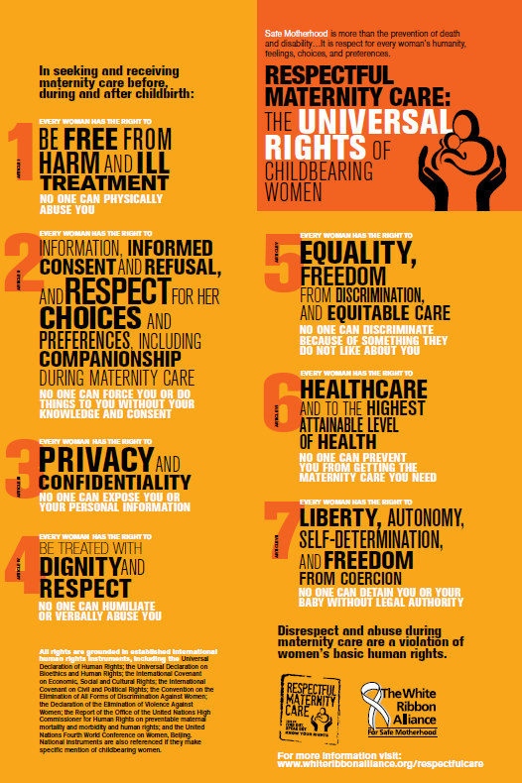
Notes:
The charter can be used to talk about the problem of disrespect and abuse during maternity care within a positive, right-based framework, so we can start to lift the “Veil of Silence” on this issue.
The charter builds a strong positive global standard for Respectful Maternity Care and affirms maternal health rights as basic human rights grounded in international declarations
We hope the Charter can be used to:
Raise awareness of the problem in a way that avoids blaming/shaming
Show that the rights of childbearing women have already been recognized in guarantees of human rights
Provide a tool for advocacy at all levels and a basis for accountability
Provide a platform for building childbearing women’s sense of entitlement to quality maternity care by aligning it with international human rights
Serve as a guide for healthcare workers as they provide maternity care to women in their facilities.

Slide 17
Discussion
How can you use the Respectful Maternity Care charter to address disrespect and abuse in your sector/setting?
Notes:
Every month, the global WRA Action of the Month will focus on Respectful Maternity Care.
We hope that you will be inspired to visit the website and Take Action!

Slide 18
Suggestions
How Respectful was YOUR maternity care experience? Share your story as a receiver or provider of maternity care or ask your mother, sister, wife, daughter to tell you about her experiences. Please submit to: takeaction@whiteribbonalliance.org
What does RESPECTFUL MATERNITY CARE look like? Get creative and share your vision of RMC in any medium (painting, photography, video, poetry, collage, drawing) . Please submit to: takeaction@whiteribbonalliance.org
Host a discussion with friends, colleagues or community members about respectful maternity care. Download this PowerPoint and tips for discussion.
Notes:
As a caregiver ask YOURSELF how would YOU like to be treated if you were giving birth in your facility. List 5 things that YOU would want during YOUR care.

Slide 19
For more information, please visit: www.whiteribbonalliance.org/respectfulcare
JOIN US: FIND OUT! SPEAK OUT!
THANK YOU!!

